Slide 1
Dealing with Data 2: Multiple Data Sets
UIUC ECON 474 Econometrics of Policy Evaluation

Slide 2
Overview
Next time: review all assigned R4DS chapters
Today:
Combining data with joins
The different types of joins
Practice joining data and other data cleaning tasks

Slide 3
Data Columns: Keys and Values
Joining on keys unlocks merging

Slide 4
Keys: country, year (ID columns) Values: nominal GDP, unemployment rate (data)
Country | Year | Nominal GDP
Canada | 2019 | 1,742 bn USD
Canada | 2020 | 1,645 bn USD
Mexico | 2019 | 1,269 bn USD
Mexico | 2020 | 1,091 bn USD
United States | 2019 | 21,381 bn USD
United States | 2020 | 21,060 bn USD
Country | Year | U-Rate
Canada | 2019 | 5.8%
Canada | 2020 | 9.6%
Mexico | 2019 | 3.5%
Mexico | 2020 | 4.4%
United States | 2019 | 3.7%
United States | 2020 | 8.1%
Source: https://fred.stlouisfed.org/

Slide 5
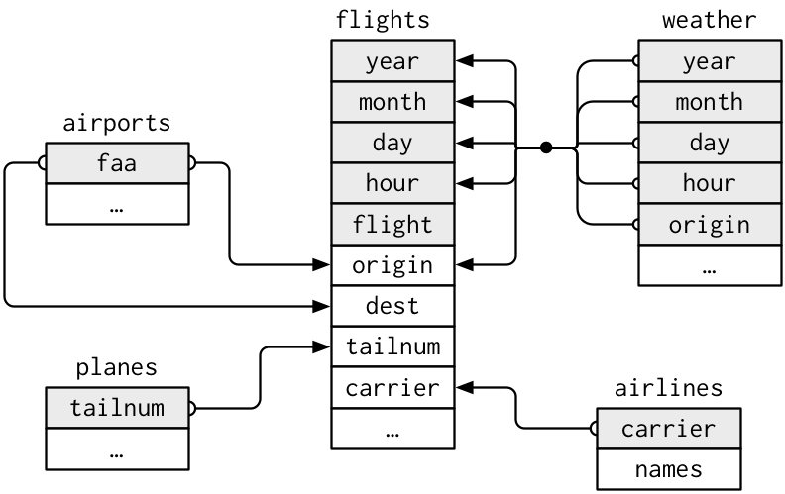
Consider the five data sets:

Slide 6
Data can be merged by “keys” (ID columns)
Each data set has
keys: talinum, origin, date, etc.
values: …, names
You can combine all five data sets into one data set by “joining” them on their keys

Slide 7
Joining Data Sets
The dplyr package

Slide 8
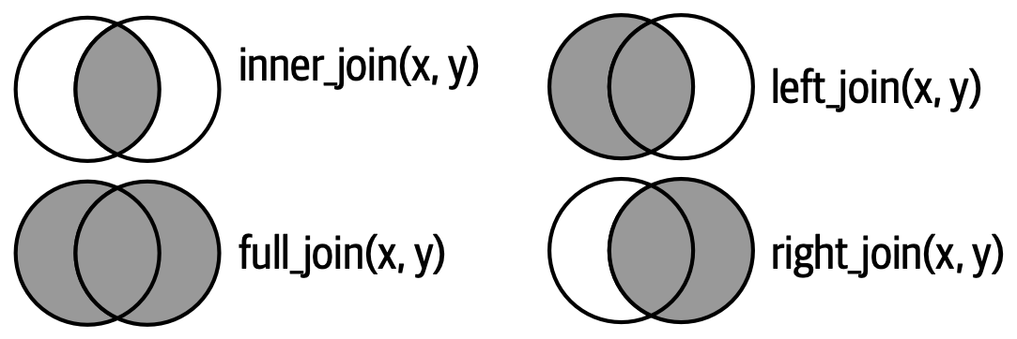
The Venn diagram of joining data

Slide 9
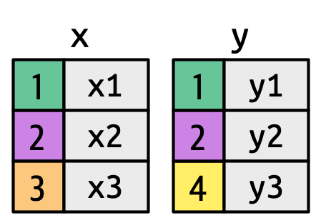
Simple multiple data set setup

Slide 10
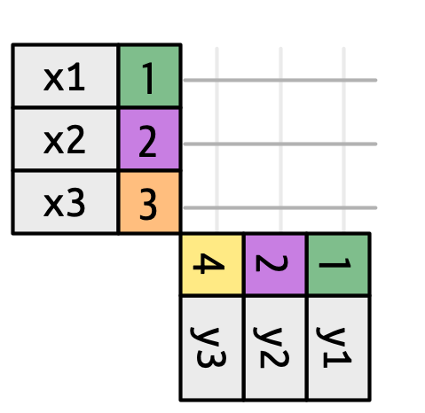
Graphical intuition: line up key values in a grid

Slide 11
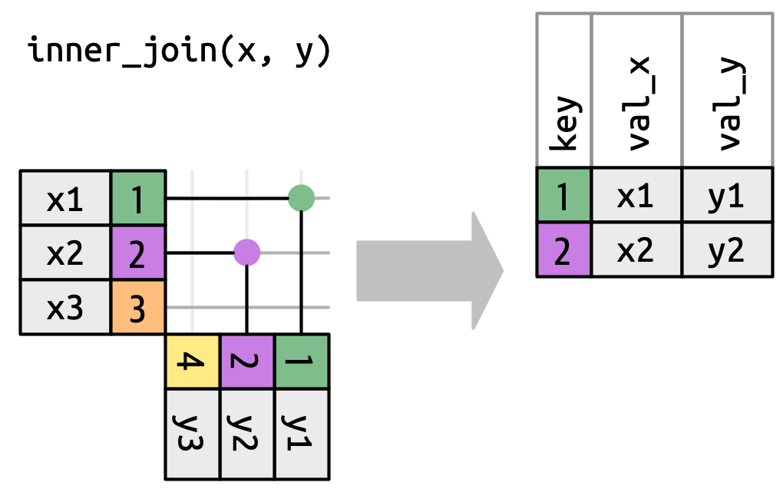
Inner join: keep observations with matching keys

Slide 12
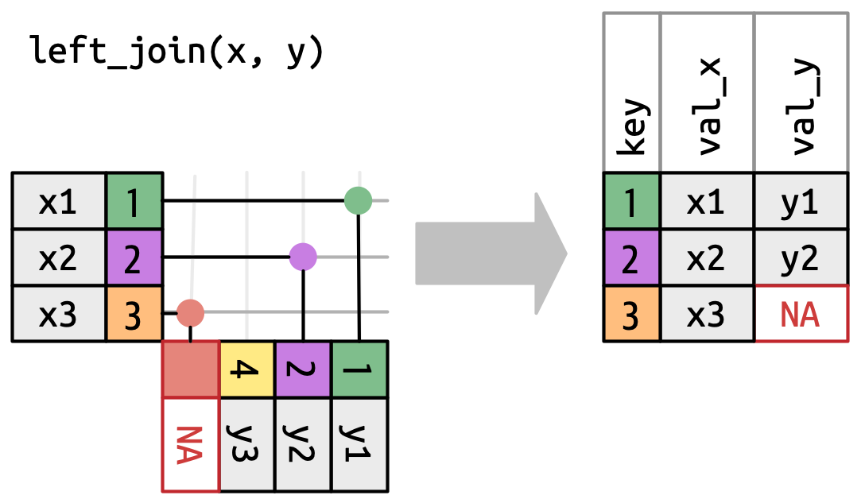
Left join: keep all “left” observations

Slide 13
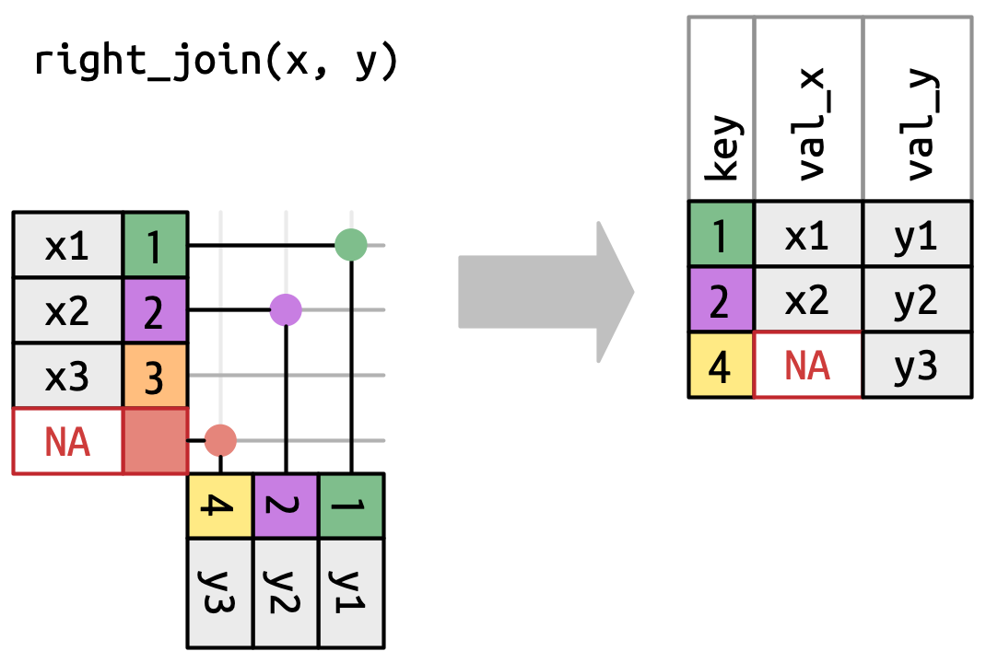
Right join: keep all “right” observations

Slide 14
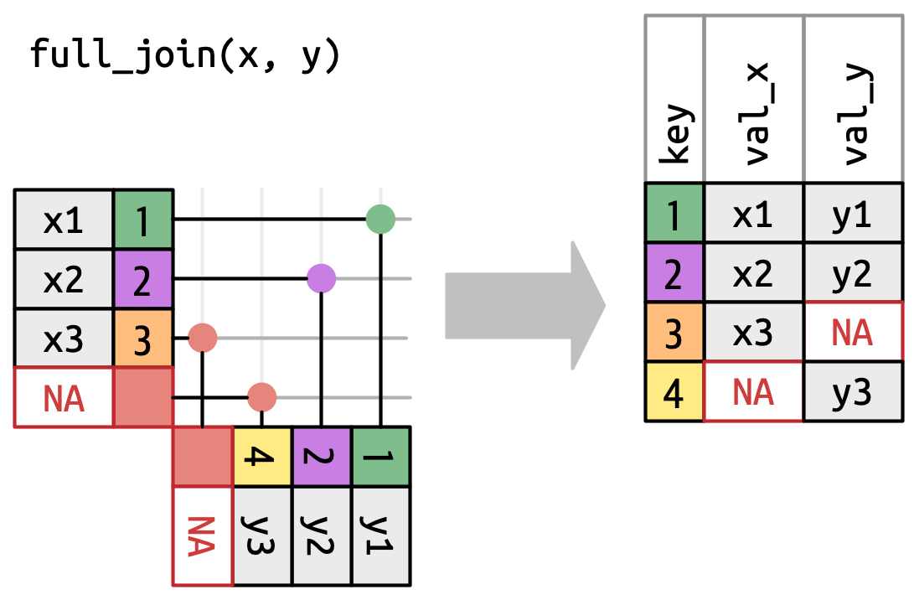
Full join: keep all observations

Slide 15
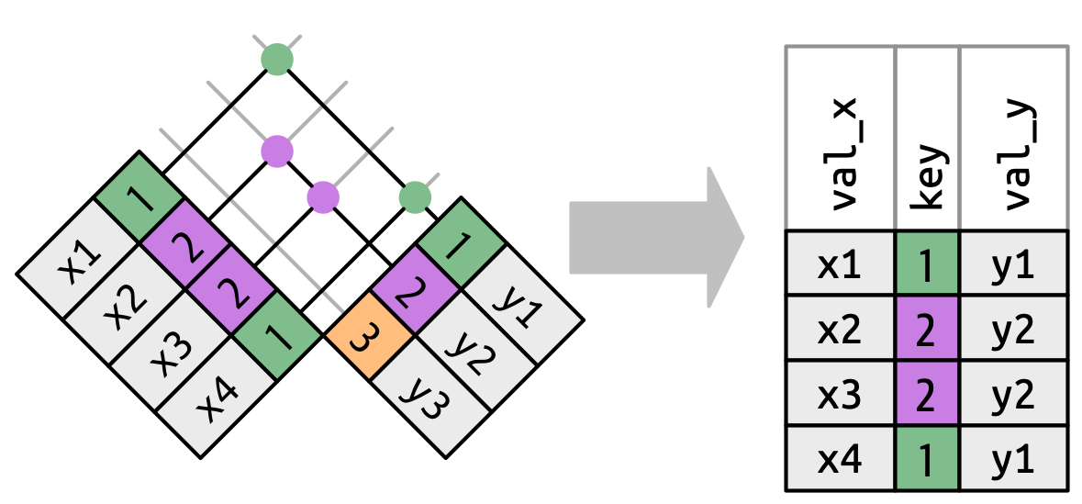
Be careful with duplicate keys…

Slide 16
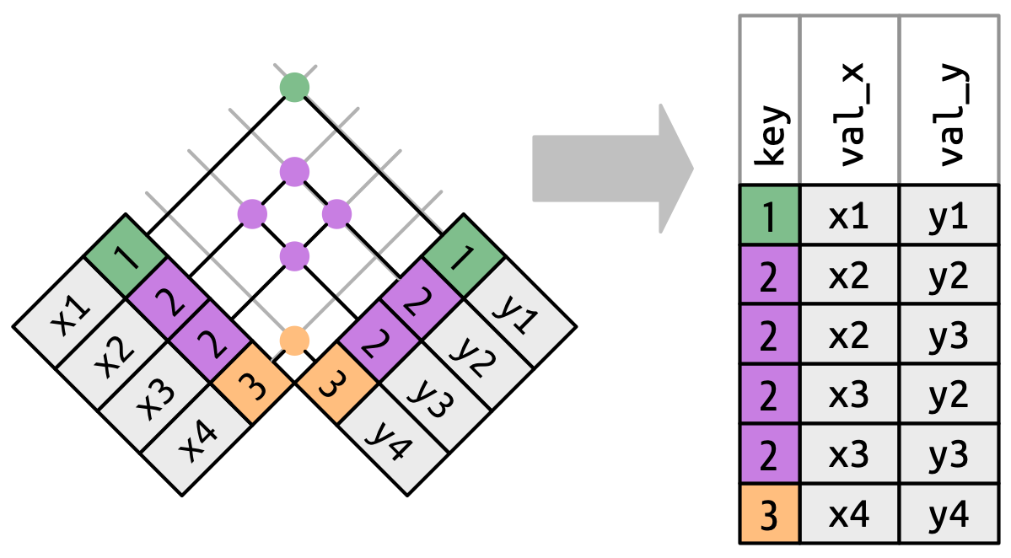
…the size of your data can explode!

Slide 17
You can join on multiple keys

Slide 18
Today’s task
Unemployment and COVID-19 cases

Slide 19
What we are up to:
Goal: create a data set containing monthly, state-level
unemployment rates
new COVID-19 cases
Create a figure (time permitting)
Sources:
Unemployment: Bureau of Labor Statistics (BLS) Current Population Survey (CPS) via IPUMS
COVID-19 Cases: John Hopkins University via GitHub

Slide 20
Dealing with the Current Population Survey
The CPS is a monthly survey: sampled data unlikely matches USA population
Requires adjusting statistics (e.g. averages) with sample weights
equal to the inverse probability of sampling a specific individual
All variables are numerically coded (demonstrative cleaning):
NAs: 9999, 9999.99, (sometimes -1, -5)
Categorical variables: employment status, education, marital status, state, binary gender, etc.

Slide 21
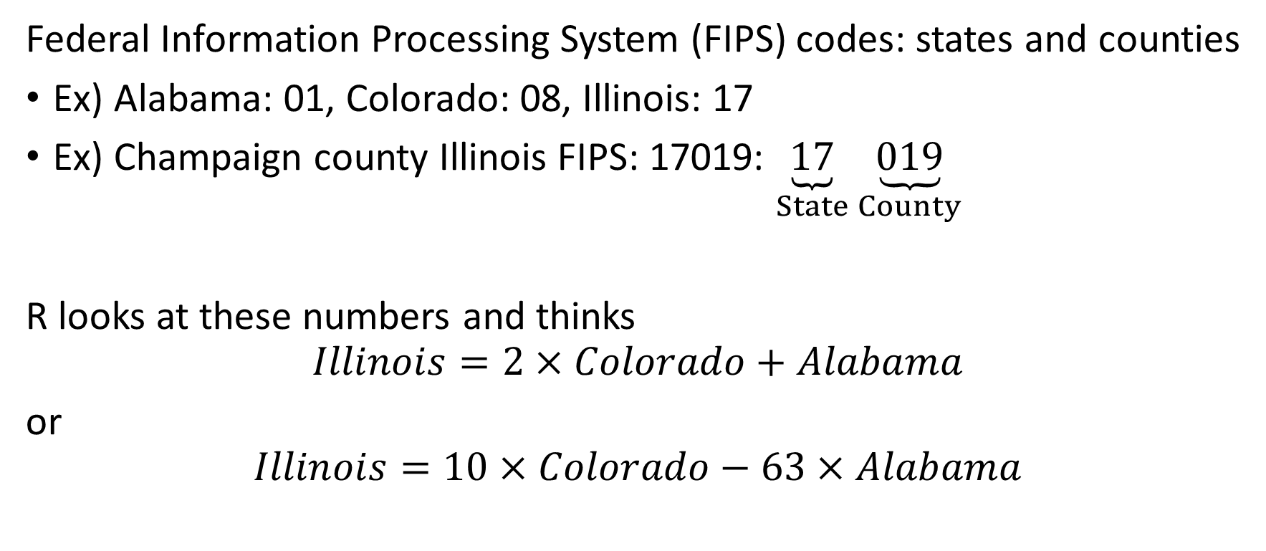
Computers a dumb, or at least literal
Federal Information Processing System (FIPS) codes: states and counties
Ex) Alabama: 01, Colorado: 08, Illinois: 17
Ex) Champaign county Illinois FIPS: 17019: $\underset{State}{\underbrace{17}}\underset{County}{\underbrace{019}}$
R looks at these numbers and thinks
$$Illinois=2×Colorado+Alabama$$
or
$$Illinois=10×Colorado−63×Alabama$$

Slide 22
Dealing with COVID-19 data
Remotely download from GitHub
Discuss remote access good practices
Data are daily cumulative cases and in wide format over all USA territories
drop non-state/DC observations (e.g. Guam, Puerto Rico)
pivot and aggregate to monthly level
create new cases variable
Non-states (e.g. cruise ships) are coded as states
drop them

